Slide 1
Module 3 Final Project Presentation
Terry v. Ohio
An investigation into the aspects and features of police activity by analyzing data from the Seattle police department
By: Rachel Beery

Slide 2
The background of Terry v. Ohio
Story
Question
Resolution
Terry and two other men were observed by a plain clothes policeman in what the officer believed to be "casing a job, a stick-up." The officer stopped and frisked the three men, and found weapons on two of them. Terry was convicted of carrying a concealed weapon and sentenced to three years in jail.
Was the search and seizure of Terry and the other men in violation of the Fourth Amendment?
In an 8-to-1 decision, the Court held that the search undertaken by the officer was reasonable under the Fourth Amendment and that the weapons seized could be introduced into evidence against Terry.
The Court found that the searches undertaken were limited in scope and designed to protect the officer's safety incident to the investigation.

Slide 3
What questions do we want to answer?
What officer and subject demographics influence policing including arrests?
Is there a difference in demographics among the different call types?
Does gender have an influence on certain arrests/stops?
Does carrying a weapon affect subject arrested?
Using a machine learning model can we find what feature has the most influence on an arrest?

Slide 4
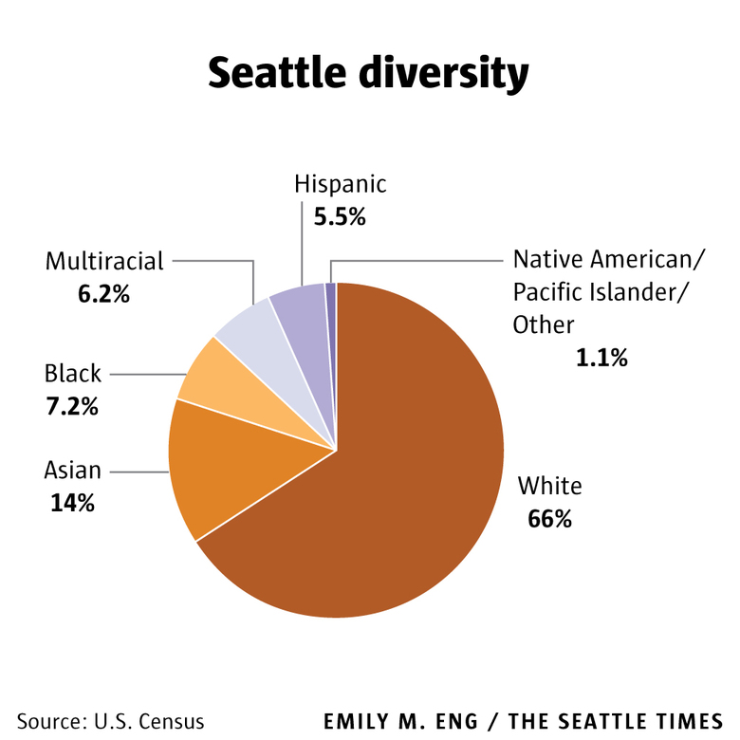
Seattle Demographics

Slide 5
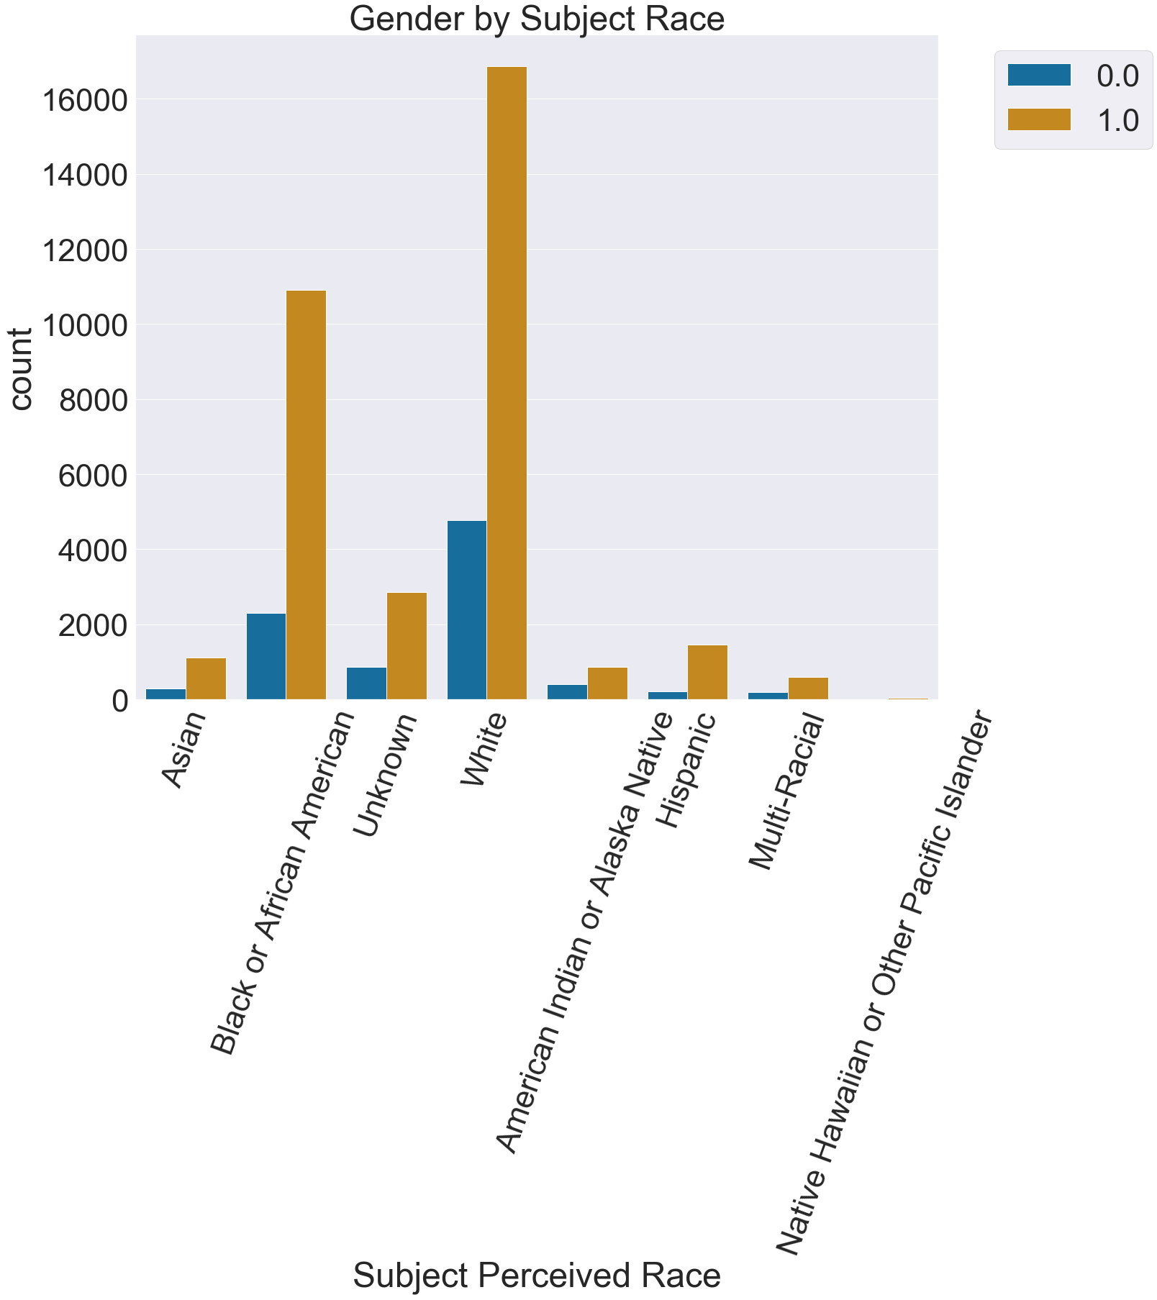
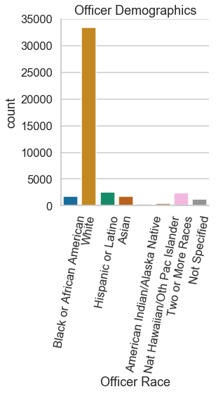
What officer and subject demographics influence policing including arrests?

Slide 6
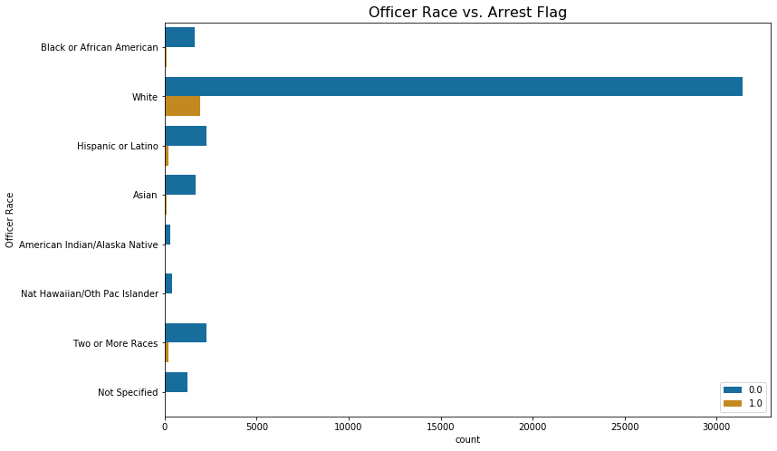

Slide 7
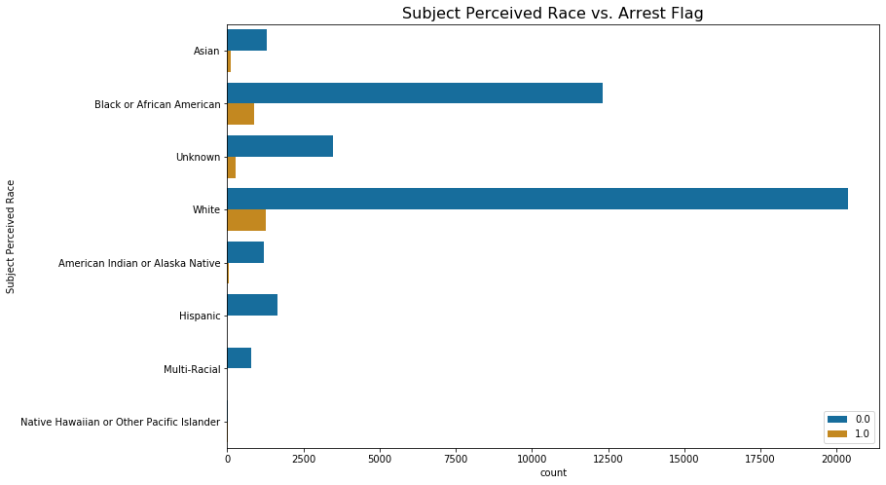

Slide 8
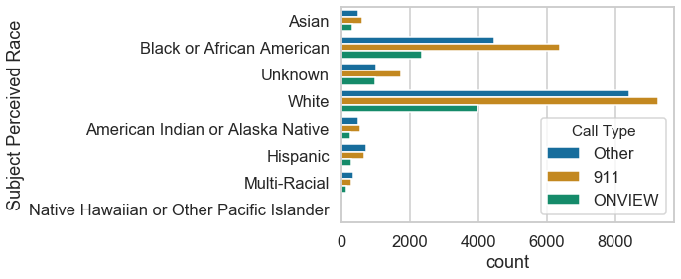
Is there a difference in demographics among the different call types?

Slide 9
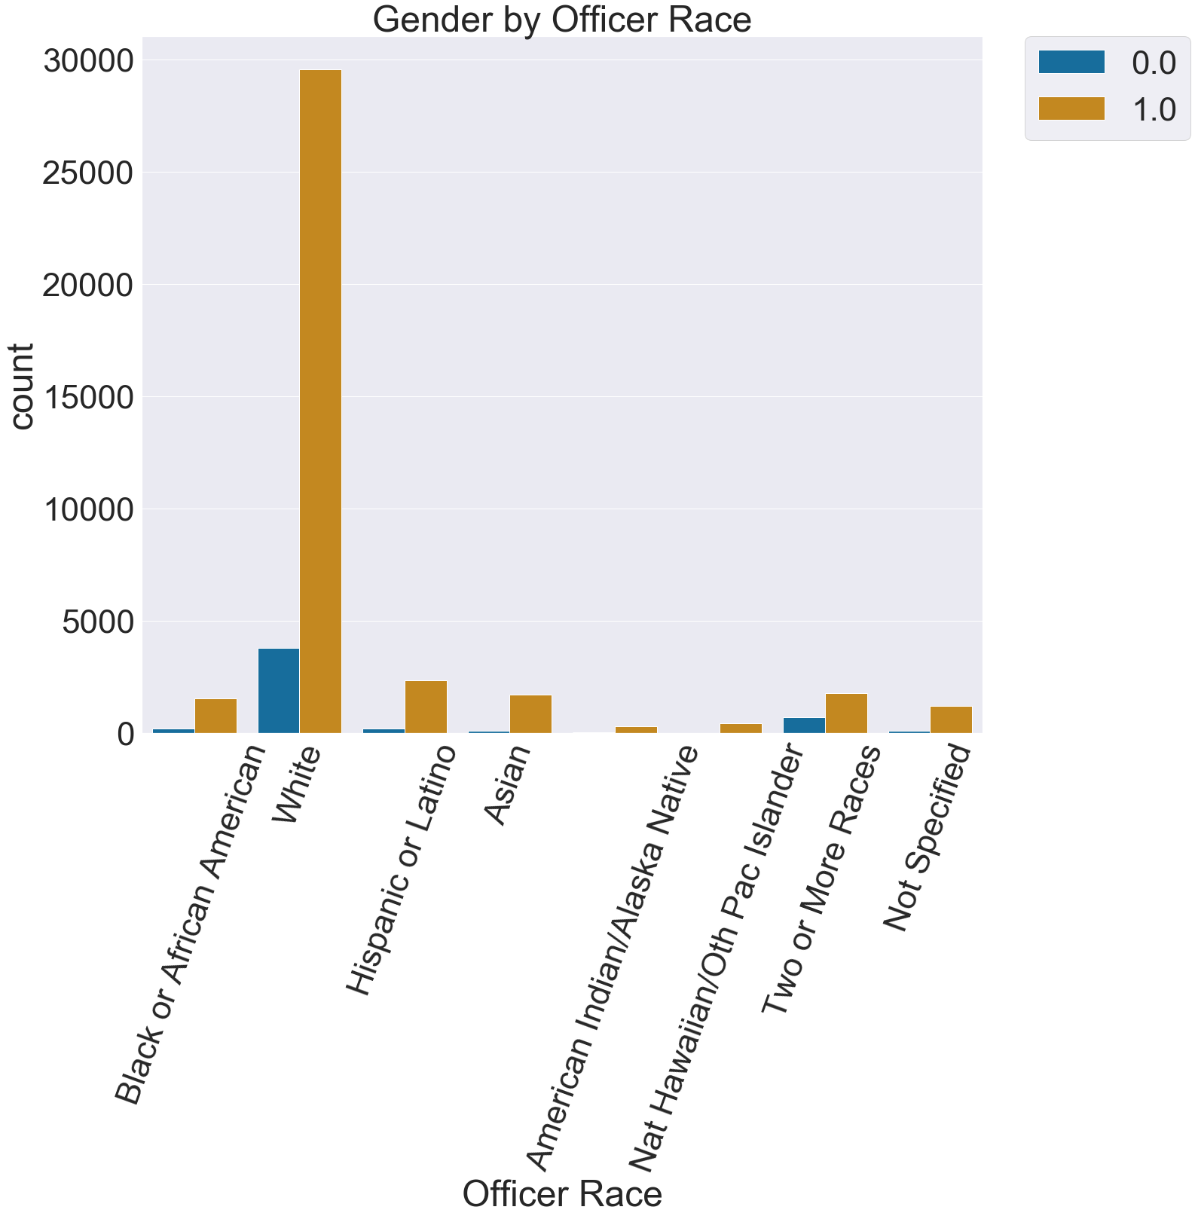
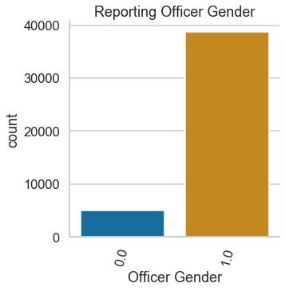
Does gender have an influence on certain arrests/stops?

Slide 10
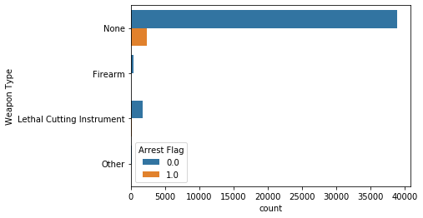
Does carrying a weapon affect subject arrested?

Slide 11
Feature Importance Results

Slide 12
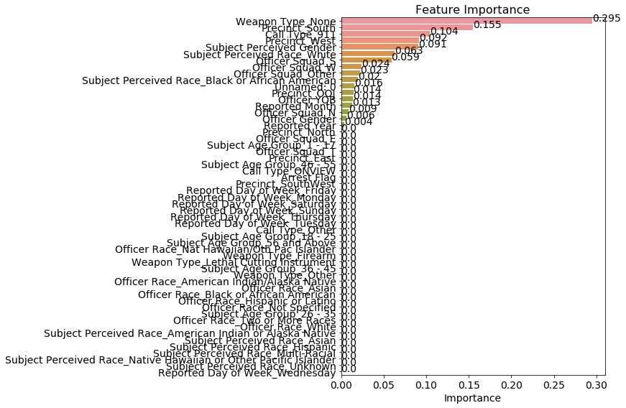
No Weapon
Precinct South
Call Type 911
Precinct West
Subject Perceived Gender White

Slide 13
Recommendations
If given more time and resources I would suggest the following
Recruitment of a more diverse officer workforce in Seattle
There is a lack of female officers
There is a lack of officers of other races other than white
Better record keeping
There was a consistent 12,776 rows of missing values or nulls
Research into why certain precincts have more frisks and arrests
Precinct South and West

Slide 14
Thank you!
Data provided by Seattle Police Department and Flatiron School at the following website:
https://catalog.data.gov/dataset/terry-stops

